Slide 1
CSE408 Recurrence equations
Lecture #12

Slide 2
Substitution method
The most general method:
Guess the form of the solution.
Verify by induction.
Solve for constants.

Slide 3
Substitution method
The most general method:
Guess the form of the solution.
Verify by induction.
Solve for constants.
EXAMPLE: T(n) = 4T(n/2) + n
[Assume that T(1) = Θ(1).]
Guess O(n³) . (Prove O and Ω separately.)
Assume that T(k) ≤ ck³ for k < n .
Prove T(n) ≤ cn³ by induction.

Slide 4
Example of substitution
desired – residual
desired
whenever (c/2)n³ – n ≥ 0, for example, if c ≥ 2 and n ≥ 1.
residual

Slide 5
Example (continued)
We must also handle the initial conditions, that is, ground the induction with base cases.
Base: T(n) = Θ(1) for all n < n₀, where n₀ is a suitable constant.
For 1 ≤ n < n₀, we have “Θ(1)” ≤ cn³, if we pick c big enough.

Slide 6
Example (continued)
We must also handle the initial conditions, that is, ground the induction with base cases.
Base: T(n) = Θ(1) for all n < n₀, where n₀ is a suitable constant.
For 1 ≤ n < n₀, we have “Θ(1)” ≤ cn³, if we pick c big enough.
This bound is not tight!

Slide 7
Recursion-tree method
A recursion tree models the costs (time) of a recursive execution of an algorithm.
The recursion-tree method can be unreliable, just like any method that uses ellipses (…).
The recursion-tree method promotes intuition, however.
The recursion tree method is good for generating guesses for the substitution method.

Slide 8
Example of recursion tree
Solve T(n) = T(n/4) + T(n/2) + n²:

Slide 9
Example of recursion tree
Solve T(n) = T(n/4) + T(n/2) + n²:
T(n)

Slide 10
Example of recursion tree
Solve T(n) = T(n/4) + T(n/2) + n²:
n²
T(n/4)
T(n/2)

Slide 11
Example of recursion tree
Solve T(n) = T(n/4) + T(n/2) + n²:
n²
(n/4)²
(n/2)²
T(n/16)
T(n/8)
T(n/8)
T(n/4)

Slide 12
Example of recursion tree
Solve T(n) = T(n/4) + T(n/2) + n²:
n²
(n/4)²
(n/2)²
(n/16)²
(n/8)²
(n/8)²
(n/4)²
…
Θ(1)

Slide 13
Example of recursion tree
Solve T(n) = T(n/4) + T(n/2) + n²:
n²
(n/4)²
(n/2)²
(n/16)²
(n/8)²
(n/8)²
(n/4)²
…
Θ(1)

Slide 14
Example of recursion tree
Solve T(n) = T(n/4) + T(n/2) + n²:
n²
(n/4)²
(n/2)²
(n/16)²
(n/8)²
(n/8)²
(n/4)²
…
Θ(1)

Slide 15
Example of recursion tree
Solve T(n) = T(n/4) + T(n/2) + n²:
n²
(n/4)²
(n/2)²
(n/16)²
(n/8)²
(n/8)²
(n/4)²
…
…
Θ(1)

Slide 16
Example of recursion tree
Solve T(n) = T(n/4) + T(n/2) + n²:
n²
(n/4)²
(n/2)²
(n/16)²
(n/8)²
(n/8)²
(n/4)²
…
…
Θ(1)
Total =
= Θ(n²)
geometric series

Slide 17
Recursion Tree

Slide 18
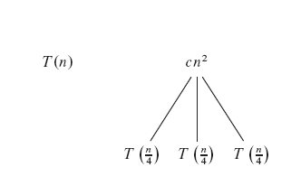
Recursion Tree

Slide 19
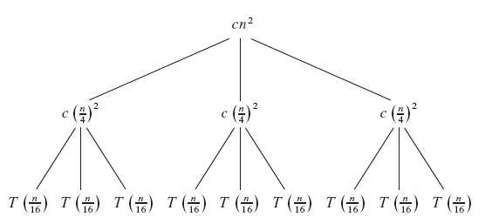
Recursion Tree

Slide 20
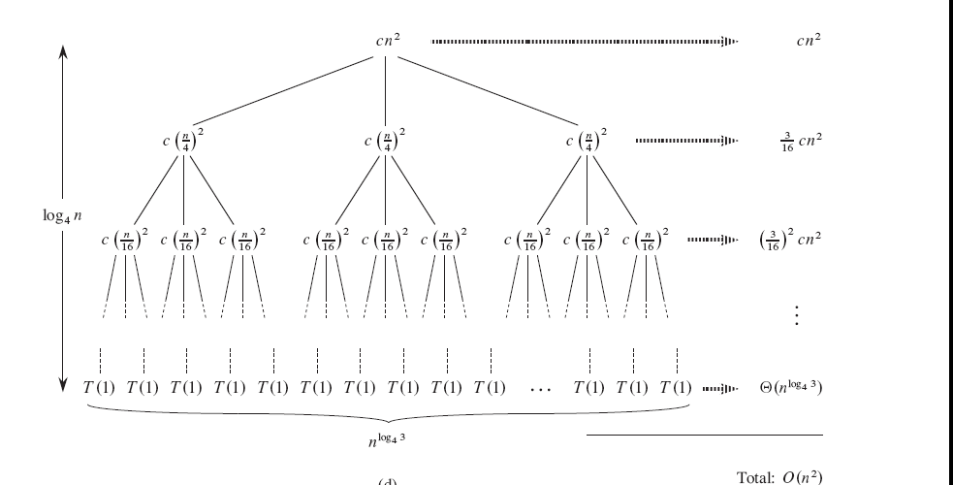
Recursion Tree

Slide 21
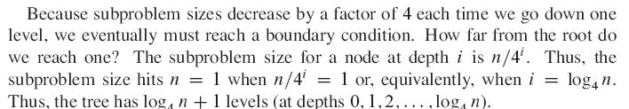
Recursion Tree

Slide 22
Recursion Tree

Slide 23
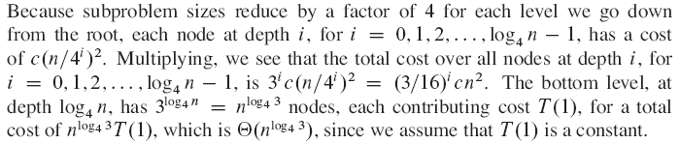
Recursion Tree

Slide 24
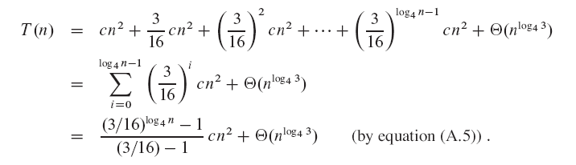
Recursion Tree

Slide 25
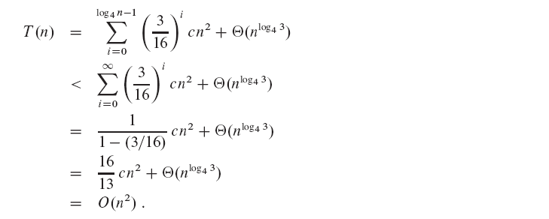
Recursion Tree

Slide 26
The master method
The master method applies to recurrences of the form
T(n) = a T(n/b) + f (n) ,
where a ≥ 1, b > 1, and f is asymptotically positive.

Slide 27
Three common cases
Compare f (n) with n^{logba}:
f (n) = O(n^{logba – ε}) for some constant ε > 0.
f (n) grows polynomially slower than n^{logba} (by an n^{ε} factor).
Solution: T(n) = Θ(n^{logba}) .

Slide 28
Three common cases
Compare f (n) with n^{logba}:
f (n) = O(n^{logba – ε}) for some constant ε > 0.
f (n) grows polynomially slower than n^{logba} (by an n^{ε} factor).
Solution: T(n) = Θ(n^{logba}) .
f (n) = Θ(n^{logba} lg^{k}n) for some constant k ≥ 0.
f (n) and n^{logba} grow at similar rates.
Solution: T(n) = Θ(n^{logba} lg^{k+1}n) .

Slide 29
Three common cases
Compare f (n) with n^{logba}:
f (n) = Ω(n^{logba + ε}) for some constant ε > 0.
f (n) grows polynomially faster than n^{logba} (by an n^{ε} factor),
and f (n) satisfies the regularity condition that a f (n/b) ≤ c f (n) for some constant c < 1.
Solution: T(n) = Θ( f (n) ) .

Slide 30
Examples
EX. T(n) = 4T(n/2) + n
a = 4, b = 2 ⇒ n^{logba} = n²; f (n) = n.
CASE 1: f (n) = O(n^{2 – ε}) for ε = 1.
∴ T(n) = Θ(n²).

Slide 31
Examples
EX. T(n) = 4T(n/2) + n
a = 4, b = 2 ⇒ n^{logba} = n²; f (n) = n.
CASE 1: f (n) = O(n^{2 – ε}) for ε = 1.
∴ T(n) = Θ(n²).
EX. T(n) = 4T(n/2) + n²
a = 4, b = 2 ⇒ n^{logba} = n²; f (n) = n².
CASE 2: f (n) = Θ(n²lg⁰n), that is, k = 0.
∴ T(n) = Θ(n²lg n).

Slide 32
Examples
EX. T(n) = 4T(n/2) + n³
a = 4, b = 2 ⇒ n^{logba} = n²; f (n) = n³.
CASE 3: f (n) = Ω(n^{2 + ε}) for ε = 1
and 4(n/2)³ ≤ cn³ (reg. cond.) for c = 1/2.
∴ T(n) = Θ(n³).

Slide 33
Examples
EX. T(n) = 4T(n/2) + n³
a = 4, b = 2 ⇒ n^{logba} = n²; f (n) = n³.
CASE 3: f (n) = Ω(n^{2 + ε}) for ε = 1
and 4(n/2)³ ≤ cn³ (reg. cond.) for c = 1/2.
∴ T(n) = Θ(n³).
EX. T(n) = 4T(n/2) + n²/lg n
a = 4, b = 2 ⇒ n^{logba} = n²; f (n) = n²/lg n.
Master method does not apply. In particular, for every constant ε > 0, we have n^{ε} = ω(lg n).

Slide 34
Thank You !!!

